Slide 1

BUSINESS ETHICS & SOCIAL RESPONSIBILITY
BY – JANITH IDDAWALA

Slide 2
DEFINING ETHICS
Ethics is a set of moral standards for judging whether something is right or wrong.
Ethics are a code of moral principles and values that governs the behaviours of a person or a group with respect to what is right and wrong
The first step in understanding business ethics is learning to recognize an ethical issue
An ethical issue is a situation where someone must choose between a set of actions that may be ethical or unethical

Slide 3
WHAT IS UNETHICAL IN BUSINESS?
Taking things that don’t belong to you
1
Saying things, you know are not true
2
Giving or allowing false impressions
3
Buying influence or engaging in a conflict of interest
4
Hiding or divulging information
5

Slide 4
WHAT IS UNETHICAL IN BUSINESS?
Taking unfair advantage
1
Committing improper personal behavior
2
Abusing power and mistreating individuals
3
Permitting organizational abuse
4
Violating rules
5
Condoning unethical actions
6

Slide 5
ETHICAL DILEMMAS
Ethical dilemmas involve situations where there are conflicting needs between two parties; individual v. organization or organization v. society.
Example -Opening up a new plant overseas.
Save $5 million by not installing standard pollution equipment. If not installed the factory could damage natural habitat and water pollution. But installing it makes it expensive to start operations.

Slide 6
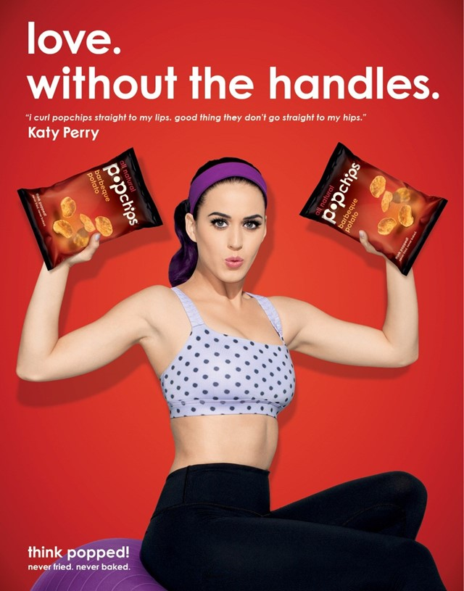

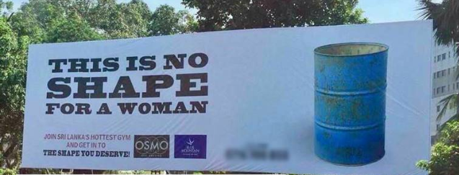
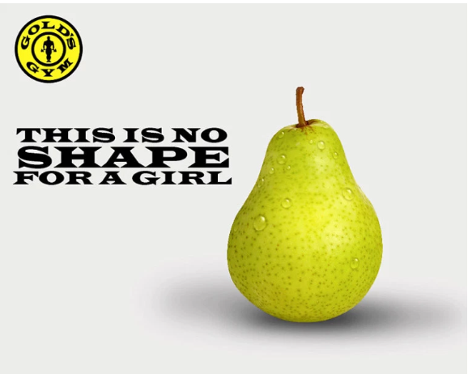

Slide 7


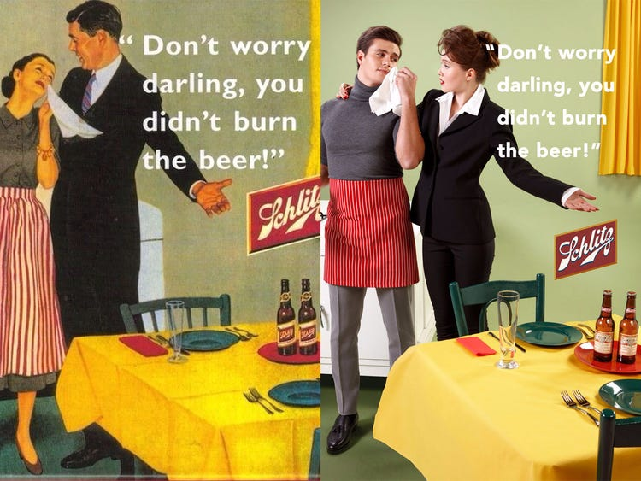

Slide 8
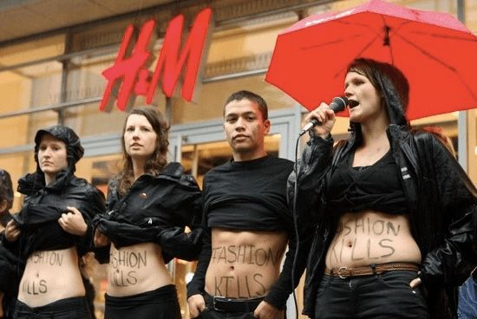
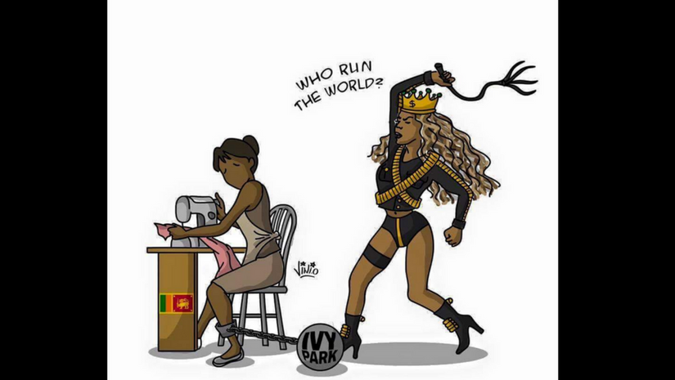

Slide 9

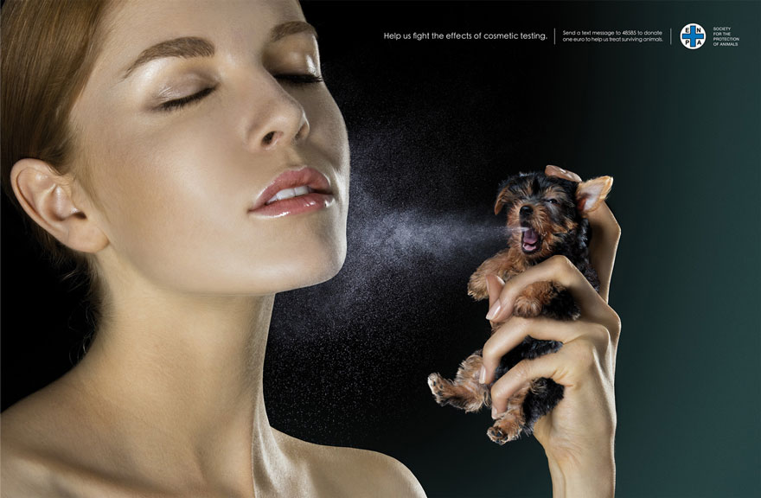

Slide 10
ETHICAL DOMAIN
Codified law is the legal framework of a country
Law does not cover all aspects; whereby certain choices are made based on ethics (one’s understanding of what is right or wrong)
Enron manipulated its financial records- illegal
Enron encouraged employees to buy shares even when directors knew that the Company was going to go bankrupt- unethical
Domain of Codified Law
Domain of Ethics
Domain of Free choice

Slide 11
SHAPING ETHICAL BEHAVIOR WITHIN AN ORGANIZATION
Written code of ethics
Formal statement of the Company’s values concerning ethics and social issues.
Creating ethical structures
Various systems, positions, and programs a company can undertake to implement ethical behaviour.
Ex- ethics committee, ethics officer, ethics hotline, ethics training and chief ethics officer.

Slide 12
SHAPING ETHICAL BEHAVIOR WITHIN AN ORGANIZATION
Creating an environment conducive for whistle-blowing
Whistle-blowing occurs when employees reveal illegal, immoral or illegitimate practices of the employer.
Ex- Ethical hotlines at Dell
Ethical leadership
Managers are honest, fair in their dealings and behaves ethically in both their personal and professional lives.

